Slide 1
Business Cases: what we’re doing in Canada
Lloyd McKenzie
June 26, 2018
Notes:
Good afternoon.
Before coming on this trip, I didn’t know a huge amount about Russia. I knew you had an amazing national anthem. I knew you were almost as good at hockey as Canada is. But I didn’t know much about how healthcare worked here, though I was pretty sure that we had more in common than the Canada does with our U.S. neighbor. We both have relatively low populations for our size. We both have government funded healthcare plus some private healthcare. And we both have a set of regions with some degree of autonomy.

Slide 2
This presentation
Can be downloaded here:
https://github.com/FHIR/documents/blob/master/presentations/2018-06%20Russia/FHIR%20in%20Canada.pptx
Is licensed for use under the Creative Commons, specifically:
Creative Commons Attribution 3.0 Unported License
(Do with it as you wish, so long as you give credit)
Notes:
As before, this presentation is licensed under creative commons. I’ll give it to the organizers who can make it available to you

Slide 3
Overview
Background on the Canadian environment
What’s happening in Canada with FHIR
Themes and additional use-cases for FHIR
Notes:
I’m going to start by providing some background and history about healthcare interoperability in Canada. Then I’m going to share some insights about what Canada’s been doing around FHIR so far and where it seems likely to be going in the near-future. Finally, I’ll talk about some of the other business cases countries have developed around FHIR.

Slide 4
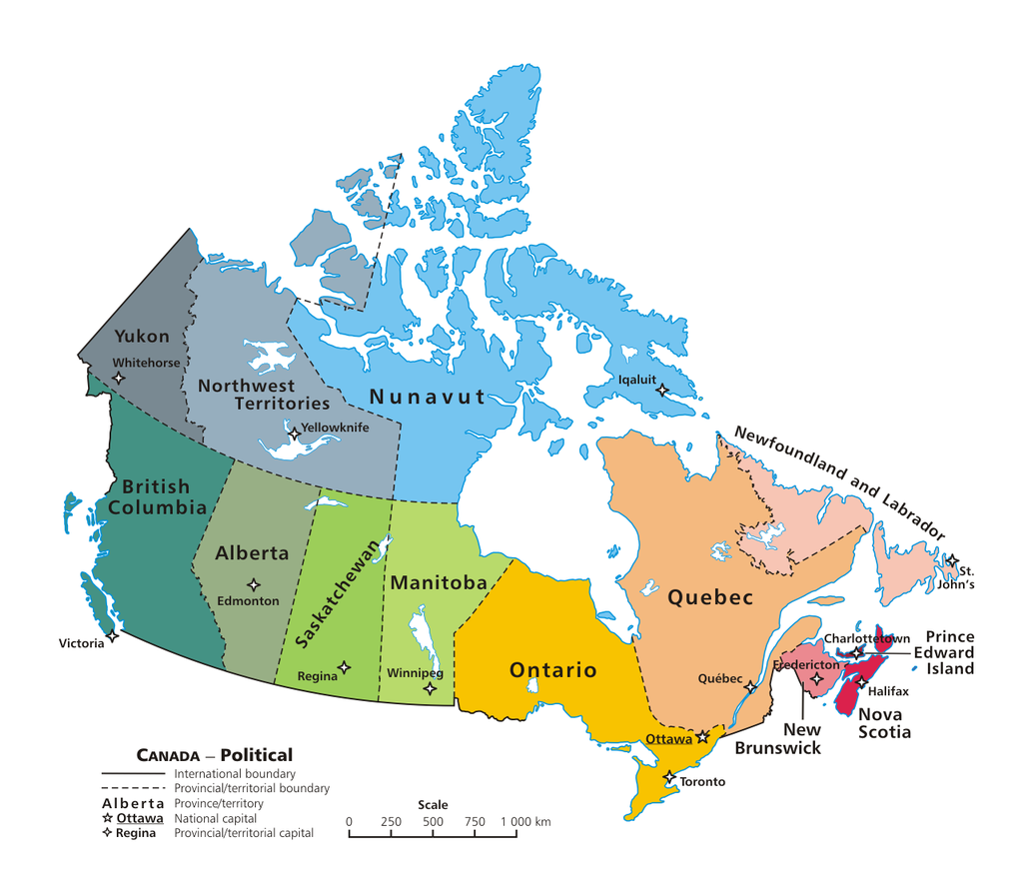
The Canadian landscape
Public healthcare system
Funded at national level
Delivered at national, provincial, territorial & sometimes regional level
Notes:
In Canada’s case, while healthcare is mostly funded by the federal government, delivery is managed by each province and territory individually. Some of them further subdivide that responsibility over a set of regional healthcare authorities. Each authority makes the decisions about what IT systems are purchased and what interfaces will be provided. In addition to the varying systems of our 10 provinces and 3 territories, the federal government has responsibility for the healthcare of certain individuals, including indigenous Canadians, the military, RCMP and federal prisoners. So we essentially have 14 independent healthcare systems in the country, with a small amount of supplementation by private healthcare.

Slide 5

Infoway
Jointly funded by provinces & federal government
Mission: accelerate the development, adoption and effective use of digital health solutions
Initial funding of $1.9 billion CAD (~90 billion rubles)
Subsequently bumped to about $2.4 billion CAD
Notes:
About 15 years ago, there was a significant push towards electronic health records. The provinces and territories agreed to divert some of the funding that would normally come to them into a new organization called Canada Health Infoway. The mandate for the organization was to design the architecture and standards for a provincially managed, interoperable electronic health record and then fund provinces and territories to get it up and running.
Obviously FHIR didn’t exist yet. The glowing newcomer at that point was HL7 version 3. And that’s what Infoway promoted. I helped. I was deeply involved in creating many of the national standards, doing training, etc. V3 wasn’t terribly popular with implementers, but the provinces were spending significant money and some of them were using regulation and reimbursement rules to essentially force implementation. Overall, the country spent over $2 billion. (Around 40 billion Rubles.)

Slide 6
Standards in Canada
HL7 v2 is common for in-hospital communication
New community focus was principally HL7 v3 messaging
Ended up with provincial silos
Some use of CDA
(FHIR didn’t exist when we allocated most of the money ☹)
Standards fatigue had set in by the time FHIR came along
Notes:
Most of that work was completed about 5 years ago, so just as FHIR was starting to be developed. At that point, our environment was a mixture of standards. Hospitals used HL7 v2 internally and sometimes to share lab data. Most of the provinces had HL7 v3 based client registries, imaging repositories. Some of them v3-based e-prescribing systems. A few had patient-accessible portals sharing other information. However, very few of those systems could talk to each other. And we’re now in a place where Canada is one of the few v3 adopters in the world (the Netherlands and the UK are the other big ones) and there is little support any more in terms of tooling or interest in HL7 international.
The jurisdiction that managed to accomplish the least in terms of setting up an electronic health record was our largest province – Ontario. They had numerous political scandals, went through a few different reorganizations and managed to spend tens of millions of dollars without a whole lot to show for it.
Oddly enough that made them one of the first areas in Canada to adopt FHIR. Much of the rest of the country was feeling pretty warn out when it came to standards implementation. Everyone had spent a lot of time and money getting systems into place. And while those systems weren’t necessarily delivering all the interoperability we’d hoped for, they were too new to consider replacing. In Ontario, though, they had the benefit of seeing what had worked – or not – with other provinces implementations. FHIR was attractive because it was easier, and it avoided some of the compatibility issues with v3. Also, unlike v3, implementers actually *liked* using FHIR.

Slide 7
Canadian use of FHIR
Notes:
Overall, Canada is behind the U.S. and several other countries in terms of FHIR adoption. We’d recently tried the new HL7 ‘thing’ and it hadn’t gone well, so there weren’t a lot of eager early-adopters. That said, FHIR is now starting to grow.

Slide 8
Early days
Initial FHIR core team was Grahame (Australia), Ewout (Netherlands) and me (Canada!)
Shortly after the introduction of FHIR, another Canadian developed the FHIR HAPI interface which has become the FHIR Java reference implementation
Tried to get things moving with our first Canadian FHIR conference in 2015 – FHIR North
Notes:
In some ways, Canada was an early adopter of FHIR. Of the three initial project leads, we had Grahame from Australia, Ewout from the Netherlands and me from Canada. James Agnew, another Canadian built a new version of HAPI (which previously only supported HL7 v2) to add FHIR capabilities within the first year of FHIR’s creation. However, no implementations of FHIR happened in Canada until about 2 .5 years ago, perhaps triggered by our first FHIR-related Canadian conference – FHIR North

Slide 9
Immunization
In production ~ 2 years ago
Trial project in Ontario
Allow reporting and query of patient immunizations
Also allow FHIR representation on paper slips using 2-D barcodes
Driver was mobile-friendliness of FHIR
Feedback was:
Fast & easy to implement, implementers liked it
Drove the creation of a lot of other projects
Notes:
The vast majority of Canadian FHIR implementations thus far are in Ontario. The first implementation I’m aware of – in production for about 2.5 years is in the Immunization space. It includes ability for systems to submit immunization records as well as query for immunization record. It also allows sharing FHIR immunizations on paper using FHIR a JSON encoded 2D barcode. The driver there was a desire for something to work well with mobile applications to be consumer friendly. There was also a desire for something that would work on mobile tablets for public health nurses performing immunizations out in the community.
This was the “proof of concept” project for Ontario. The speed with which they were able to develop the specification, implement the provincial side of things and get other implementers to adopt drove the initiation of numerous other provincial projects

Slide 10
E-Prescribing
First non-government FHIR project
Supported sharing prescriptions from physician to community pharmacies, secure messaging, dispense notifications
Driver was need to have something “easy” that implementers would actually use
Production in Ontario over 1 year ago
but subsequently in production in at least one other province
Notes:
A commercially-developed FHIR messaging ePrescribing effort went live about 1.5 years ago. This was the first non-government-initiated project The driver there was to find something that would be easy enough to implement that pharmacy and physician vendors would actually implement. Many jurisdictions had rolled out v3 pharmacy implementations to track prescriptions and dispensing, but they got very limited uptake except in jurisdictions that mandated adoption (and for political reasons, that was difficult to do in Ontario). The product subsequently got adopted in a second province and may be picked up in others.

Slide 11
FHIR + legacy
Lab results
V2 to providers
FHIR to patients and others
Health reports and birth registry information
XDS + CDA to providers
FHIR + PDF to patients and others
Notes:
Other initiatives have merged legacy technologies with FHIR. Ontario lab results are still delivered to clinical systems using HL7 v2. However, they’re available to registered consumer applications using FHIR. Health reports and birth registry information are delivered to provider systems as CDA documents over XDS, but the data is made available to consumer apps as DocumentReference instances and PDFs using FHIR.

Slide 12
Registries
Provider & Patient registries designed & tested, but not production
Read-only for Patient, read-write for Practitioner
Waiting to determine who potential consumers are
Which is somewhat unusual for a government project…
Notes:
On the registry side of things, Ontario has designed and tested FHIR interfaces for both their provider and client registries, but has not put them into production, in part because it’s not yet sure what client systems will want to make use of them.

Slide 13
Planned systems
OAuth service for secure patient identity verification
Consent
eReferral
others…
Notes:
Systems for patient-based OAuth services, consent and eReferrals are also in development.

Slide 14
National scale
Institute responsible for gathering health statistics
Using FHIR to gather discharge, adverse event and other reports
Driven by desire to use “standard” rather than custom syntax
Also interested in ease of use/tools
Notes:
On a national basis, the government agency responsible for capturing healthcare statistics has begun rolling out a Questionnaire-based interface for gathering discharge, adverse event and other information.

Slide 15
What else are we doing?
5 working groups drawing from various jurisdictions
Bi-weekly calls
Topics are:
Tooling
Architecture
CDS Hooks
Registries
eReferrals
Notes:
Other jurisdictions are starting to take notice and some have been exploring FHIR-based documents as well as participating in FHIR-based calls
We now have 5 different working groups having calls ever 2 weeks on different topics including tooling, architecture, SMART & CDS Hooks, registries and eReferrals. Each has active participation and are trying to lay the groundwork for greater FHIR use in Canada.

Slide 16
FHIR North
Annual 1-day conference
Started 3 years ago
Got 260+ attendees at the most recent one
Mixture of connectathon & training
Looking to expand to 2/year
Notes:
We’ve also held yearly 1-day conferences about FHIR in an attempt to spread the word, provide training and give implementers a chance to try it out – much the same as FHIR Starter is doing here. FHIR North has grown significantly over time and we’re looking at moving to having two conferences a year.

Slide 17
Use Cases
Notes:
So, what are some of the lessons we can learn about “Why FHIR?” from the Canadian experience?

Slide 18

Mobile Friendly
RESTful interface & JSON support are “natural” for web-based solutions
APIs – including Swift make mobile solution easy
Resources are lightweight = faster response times
Documentation appeals to mobile developers, less learning curve
Notes:
One of the main attractive features of FHIR is its friendliness to mobile solutions. REST and JSON are a natural fit for interfaces designed for the web or for mobile devices. The resources themselves are relatively light-weight. There’s no need to package up large collections in order to be able to share. We also have APIs for Swift and Java that get implementers up and running quickly and documentation that’s more aligned with how mobile developers expect things to work.

Slide 19
Context-free interfaces
RESTful interface is generic
No need to define message events or payloads
Query what you need
One interface can work for multiple partners & solve multiple communication needs
Extensions allow support for specialized needs
Business rules move from the interface to the access control layer
Faster/more dynamic configuration
Notes:
Another appealing aspect of FHIR is that it’s easy to get solutions up and running. A key part of that is that the interfaces themselves are generic. There’s no need to define what the operations are or how they work, merely a need to choose which operations you want to support. It also means that a single interface can be used for multiple purposes. The interface used to expose information to clinicians might later also be used to expose relevant information to insurers. All you need to do is define the authorization rules for what that user is allowed to see.

Slide 20
Profiling and Validation
Conformance artifacts in FHIR are defined computably and resolvable computably
Allows robust validation, including terminology
Support for automated testing of interfaces
Allows sharing of profiles, clinical practice guidelines
Allows dynamic configuration of application behavior and user interface
Notes:
Almost all of the Canadian implementations are taking advantage of the profiling and implementation guide capabilities FHIR offers. Several of them are using the reference implementation validation capabilities as part of their runtime processes to check that inbound content meets their business rules. The ability to validate examples and generate a rendered specification that exactly matches internal validation rules is very helpful. And the tools to support authoring profiles and implementation guides continue to get better.

Slide 21
Documents that are easier
FHIR allows documents that are easier to use than CDA
Data can easily be consumed and used for other purposes
RESTful interface
Decision support
Etc.
Use documents for what they’re meant for, rather than everything
Notes:
Canada has moderate implementation of CDA. Several jurisdictions are looking at FHIR documents as a more implementer-friendly way of sharing documents. The data structures are easier to understand and the software APIs to manipulate resources make it easier for implementers to get started. It’s also attractive to know that the data structures used for document interfaces can also be used with other messaging and RESTful interfaces.

Slide 22



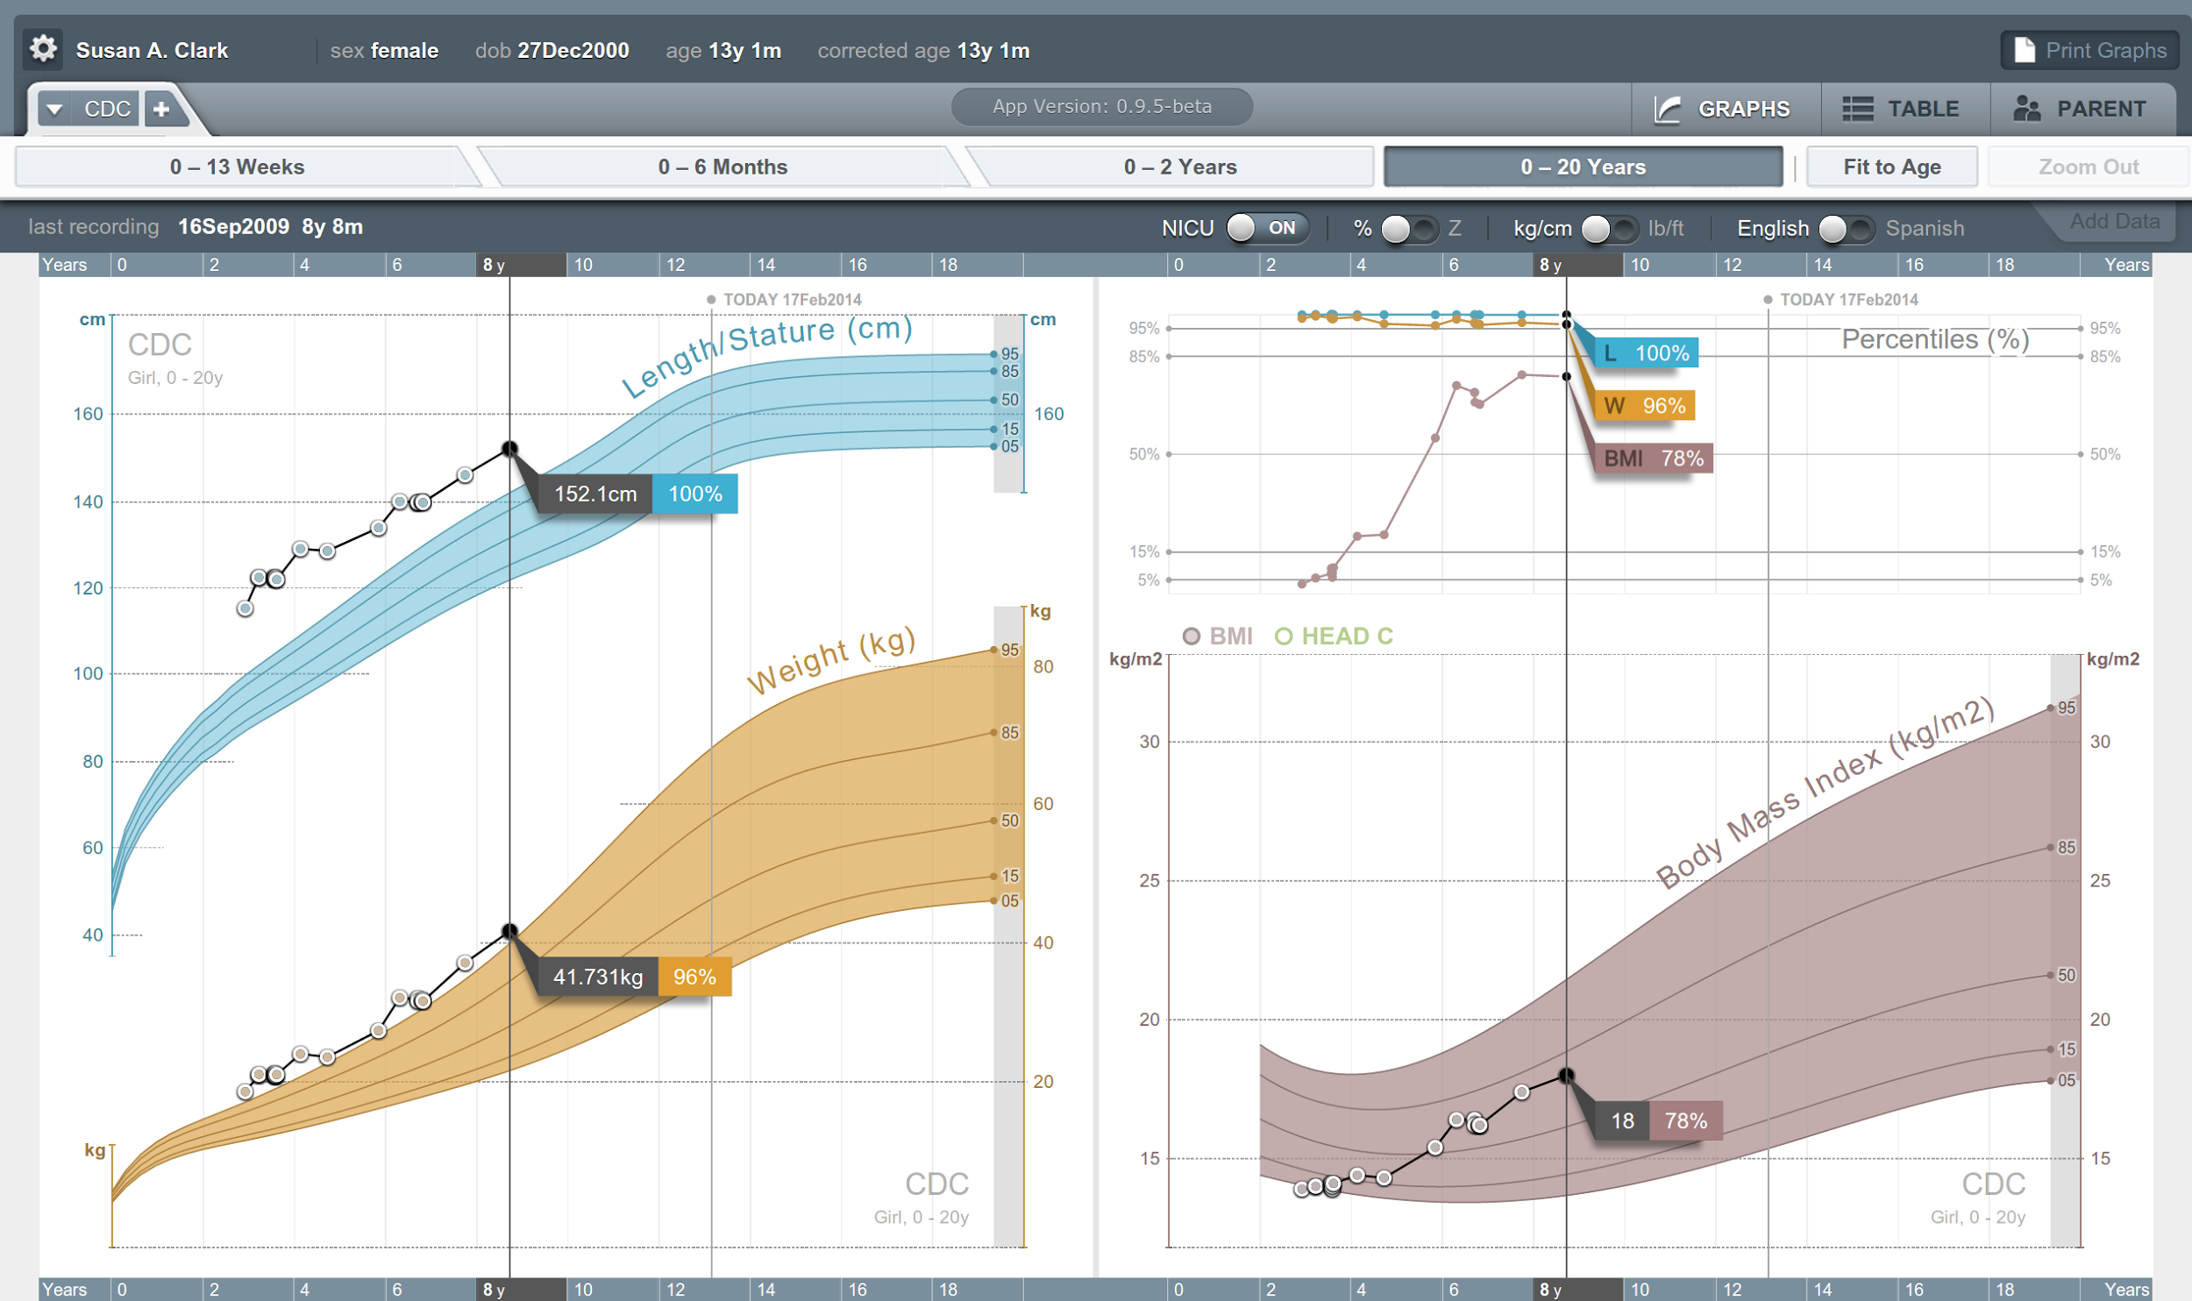


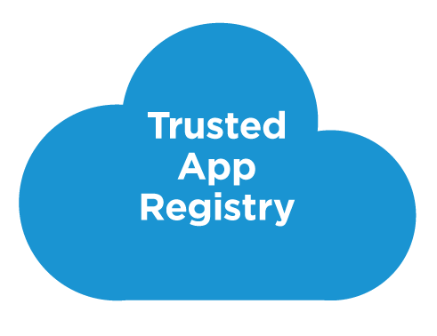



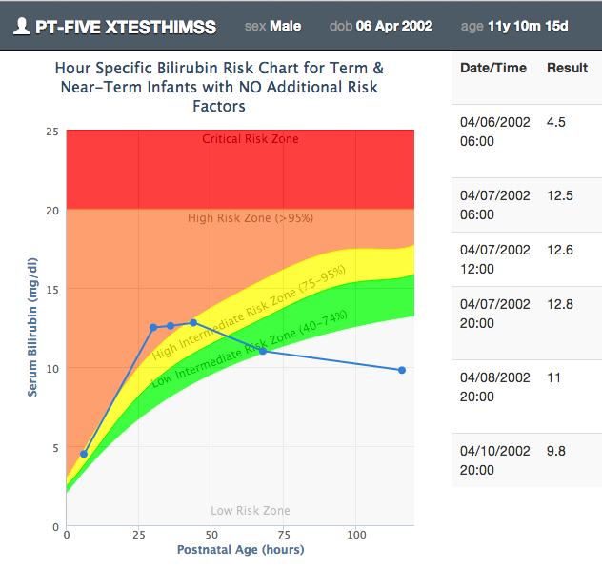

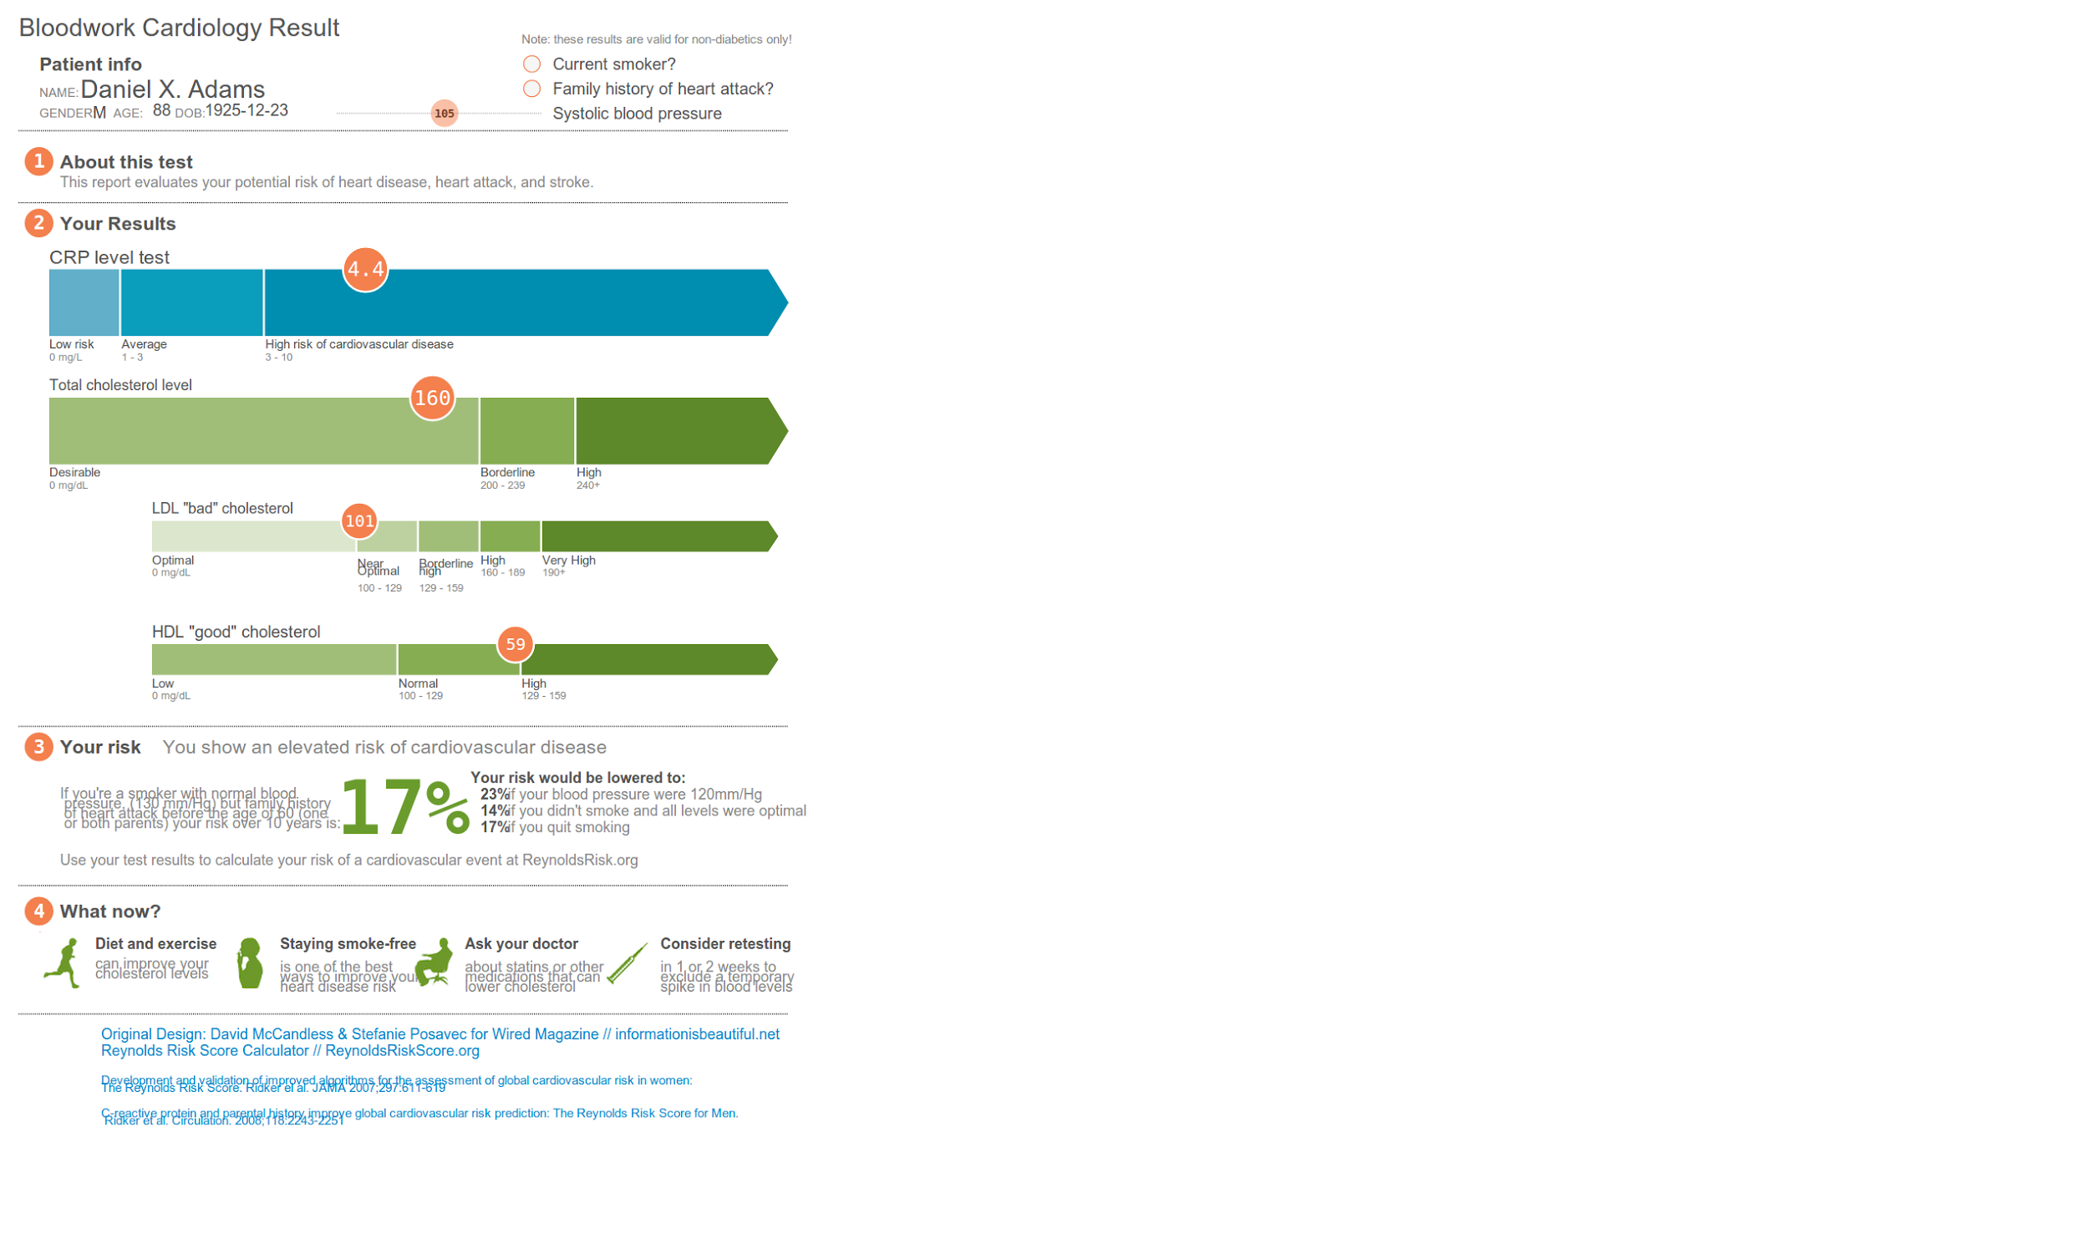





SMART on FHIR
Mobile Apps
Web Apps
OAuth2
REST API
MU-oriented FHIR Data Profiles
Underlying Health IT Systems
Your system here.
Notes:
Canada is also looking to the possibility of being able to leverage SMART on FHIR and CDS Hooks – capabilities that allow other systems to plug into EHR interfaces and workflows. Canada relies on many of the same hospital information systems as are used in the US – Epic, Cerner, etc. and those already have support for these technologies.

Slide 23
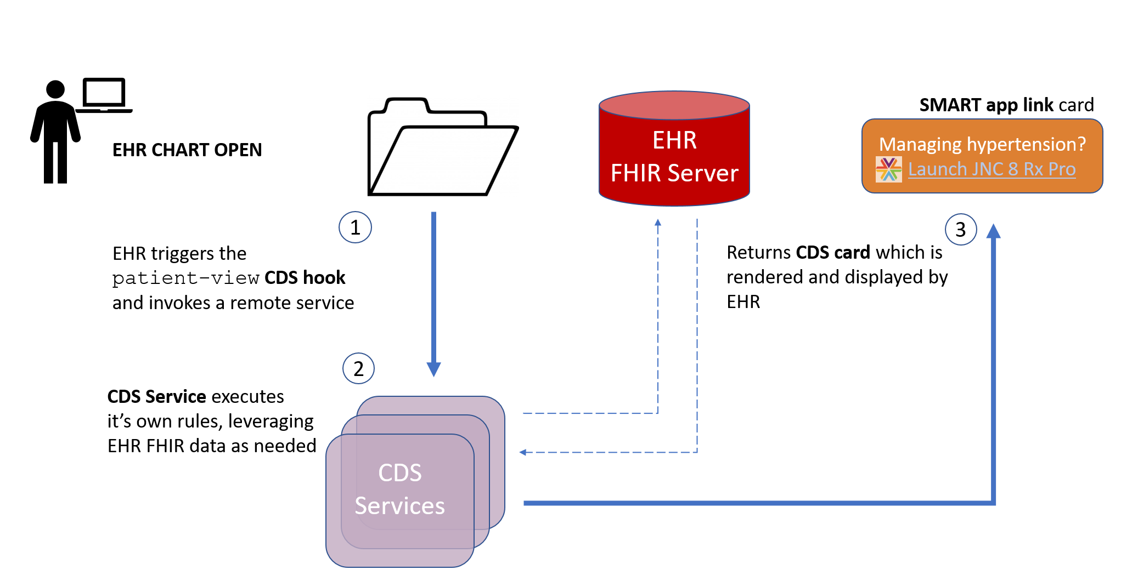
CDS Hooks
Notes:
To be used in Canada, there are several steps we need to take which we’re working our way through:
Increasing interest and awareness of these technologies for Canadian EHR systems
Creating a Canadian Core equivalent for the US Core profiles that SMART and CDS Hooks currently leverage. (This means small changes in extensions and vocabulary bindings)
Working with SMART and CDS Hooks to add “country” as part of the context for invoking those technologies so systems know what profiles apply

Slide 24
Bulk data
Most healthcare interfaces are narrow in scope
Specific patient, specific encounter, specific event
FHIR supports querying whatever’s of interest
All of a patient’s record I’m allowed to see
All data for my patients
All data related to condition X across patients
Subscriptions allow data to be pushed
Notes:
An area that hasn’t seen much interest in Canada yet, but which I expect we’ll get to eventually is “bulk data”. This is the ability for systems to extract large quantities of data from EHR and other systems for research, analysis, payment or other reasons.

Slide 25
Leverage the Community
FHIR has attracted far greater attention and energy than any previous HL7 specification
Over 10,000 change requests
Up to 2500 chat.fhir.org messages/week
~180 FHIR-related sessions at most HL7 meetings
Spawned university courses, open source projects, conferences, etc.
That energy attracts implementers and provides better support
Notes:
For me, one of the strongest reasons to use FHIR is the strength of its community. We have a global community that has a culture of interaction and support. That community has built tools, brought ideas, proposed enhancements and generally made FHIR better. That community is available to support implementers – and that support is what really results in interoperability.

Slide 26
Conclusion
Canada has been slower to adopt FHIR, but we’re speeding up
Implementation is happening both from a top-down, government led, but also bottom-up implementer led
The country is trying to build an infrastructure of processes to support future FHIR adoption
FHIR will co-exist with v2, v3 and CDA for quite some time
Notes:
FHIR has been slower to penetrate in Canada, in large part due to the HL7 v3 hangover we’re experiencing from earlier implementation experiences. However, FHIR is definitely catching on and is starting to spread. We expect it will continue to grow, though it will be running in parallel with legacy technologies for a long time.

Slide 27

Questions?
http://hl7.org/fhir lmckenzie@gevityinc.com

